Slide 1
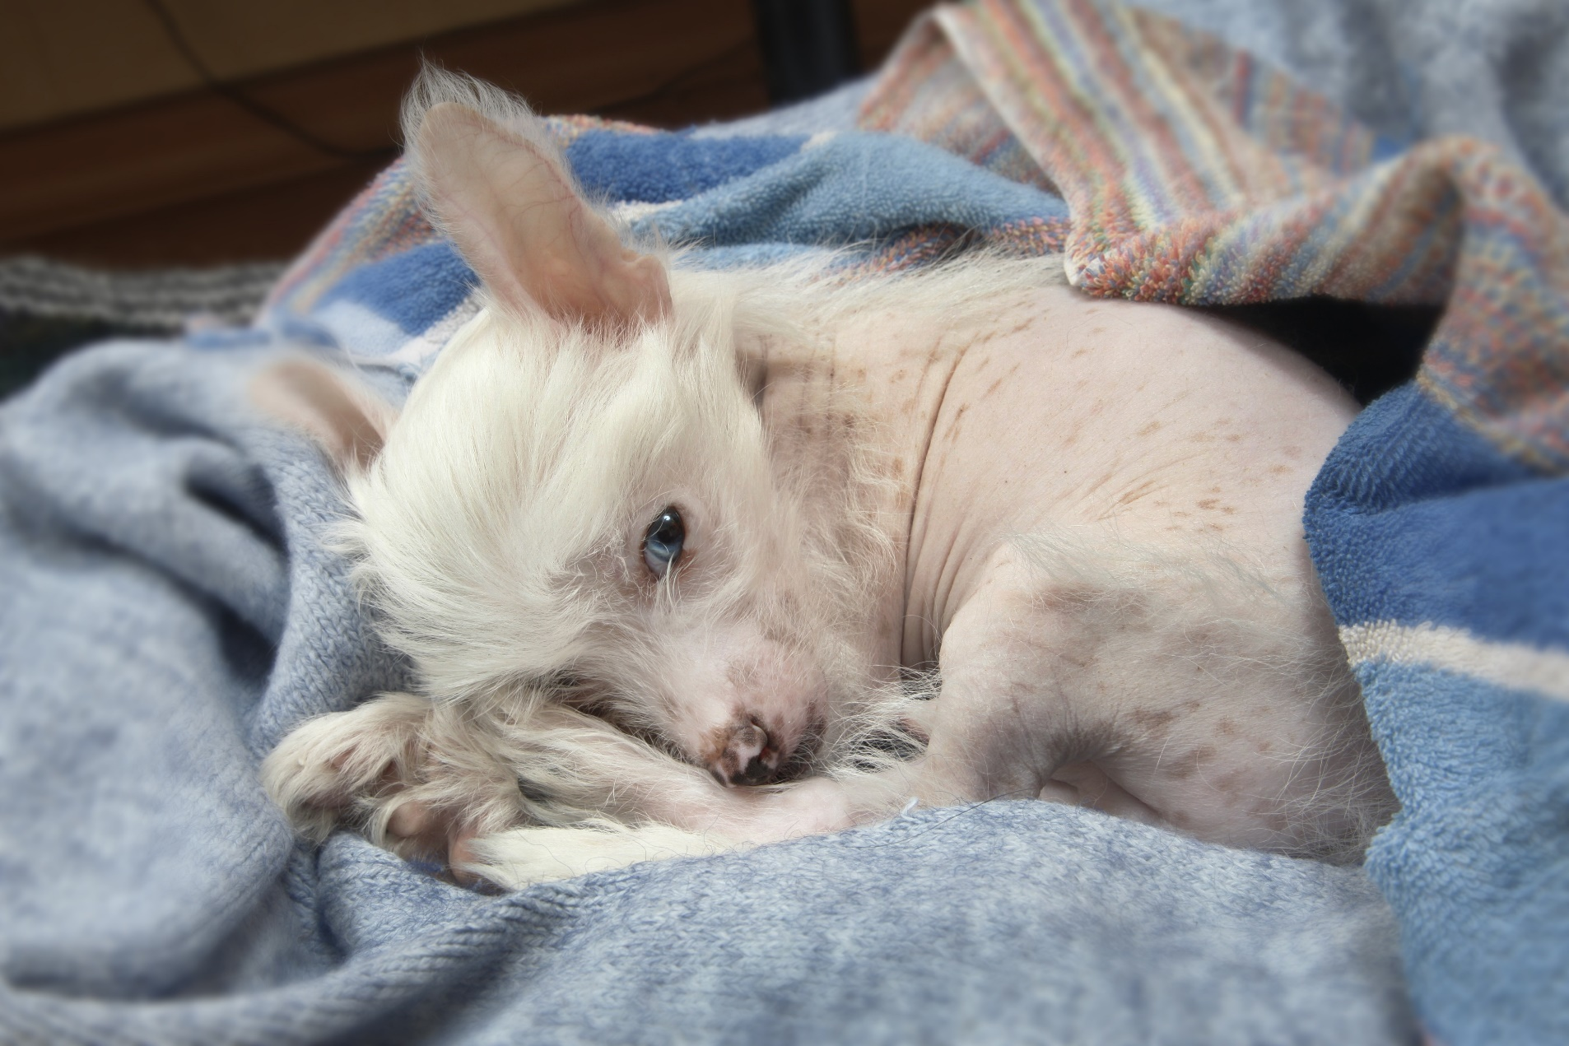
Elite Management in Renal Care, Treatment and Prevention
Henry K. Yoo, DVM MSc MBA
Hosted by
Executive Director & Consultant in
Preventive Medicine
Infinity Medical Consulting & Co.
Santa Monica, CA 90405

Slide 2
Disclaimer
The Speaker has never been paid for the promotion of the product nor represented the products in any forms. The speaker has been using the products independently over 7 years along with other products related to CKD. This presentation is totally based on the academic and professional experience as a practitioner and consultant. The speaker has no interest nor an intention to promote a particular product through this presentation.
Henry K. Yoo, DVM MSc MBA

Slide 3
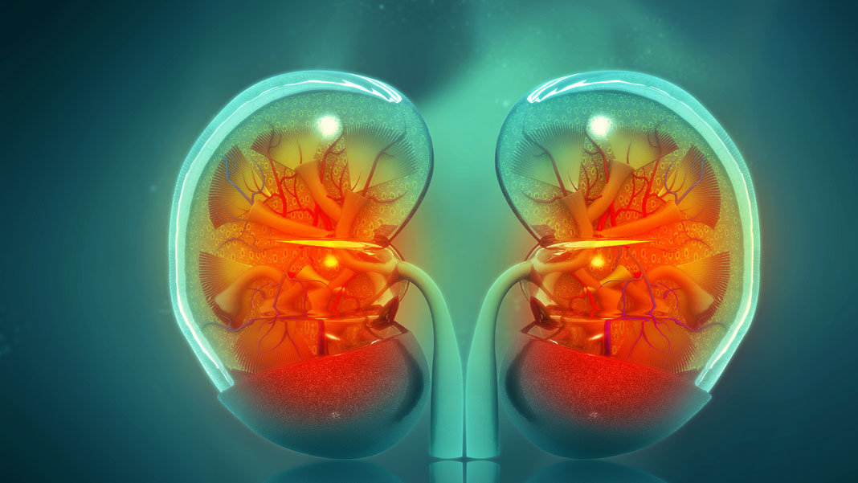
Objectives
Fundamentals in Renal Disease.
What are the measurements of Kidney stress and/or failure?
What is new in Renal Care and Treatment?
Why Renal Care & Treatment?
Best Practice and Tx, Rx Px on the Renal Care.
Dos and Don’t in the Renal Care in Private Practice
This Photo by Unknown Author is licensed under CC BY-ND

Slide 4
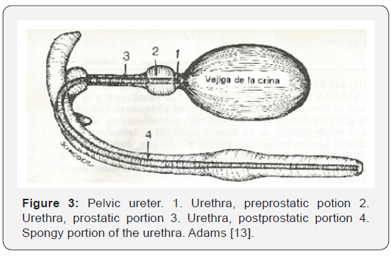
Etiology of CKD/AKD
Geriatric Changes
Genetic Factors
Lower Urinary Tract Origin
Bacterial/Micro-organism
Oncogenic Factors
Toxicosis
Immunological
This Photo by Unknown Author is licensed under CC BY

Slide 5
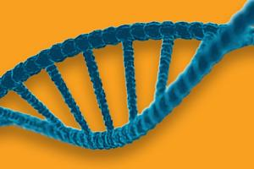
3 Models of Patients with Renal Tx, Rx and Px
Diet/nutrition related Model
Treatment & Patient Management Model
Preventive Medicine Model

Slide 6
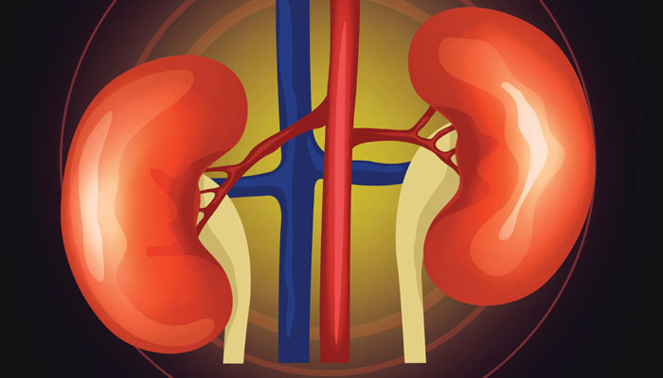
Fundamental Renal Function
Removes waste products from the body
Remove drugs from the body
Balance the body's fluids
Release hormones that regulate blood pressure
Produce an active form of vitamin D that promotes strong, healthy bones
Control the production of red blood cells

Slide 7
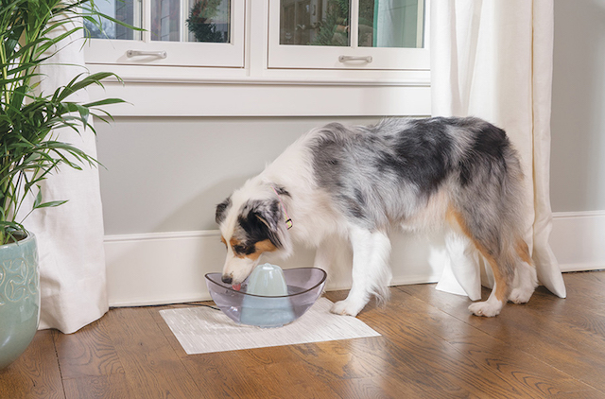
Usual Medical Complaints by Clients
Vomiting
Constant thrust
Blood in urine
Lethargy
Pale gums
Ulcers in the mouth
Intestinal seizures
Significant weight loss
Drunken behavior or movement such as stumbling
Decrease in appetite
Breath that smells like chemicals

Slide 8
NMNM (no measurement no management)
GFR
SDMA
BUN
Creatinine
BUN/Creat. Ratio
Urine Concentration
Anemia through PCV/Hb
Dehydration
This Photo by Unknown Author is licensed under CC BY-SA

Slide 9
Anemia in Human Related to CKD

Slide 10
5 CKD Stage by GFR (30-75% Damage)
Stage 1: GFR (90 or above). Kidney damage may still be detected before the GFR begins to decline.
Stage 2: GFR (60 to 89). When kidney function starts to decline and there is a need to monitor the progression of the CKD and continue treatment to reduce the risk of other health problems.
Stage 3: GFR (30 to 59). When CKD has advanced to this stage, anemia and bone problems become more common. Start to prevent or treat these complications.
Stage 4: Severe reduction in GFR (15 to 29). Continue following the treatment for complications of CKD including Hemo-dialysis, peritoneal dialysis. Time to begin discussion on kidney transplantation.
Stage 5: Kidney failure (GFR less than 15). When the kidneys do not work well enough to maintain life through dialysis or a kidney transplant.
Important things to know is in “ detection of CKD through elevated SDMA or BUN/Creatinine is when the damage took place at the almost 30% up to 75% of the Kidney cell function.

Slide 12
Most Readily-Used Renal Test in Use

Slide 13
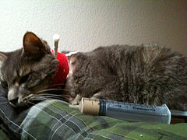
Diet Combined with Clinician Monitoring
Avoid overuse of nonsteroidal anti-inflammatory drugs (NSAIDs), which can damage kidneys.
Schedule regular checkups (Q 2 months) to monitor kidney function, anemia and hydration of the body.
Consider Kidney-friendly diet & supplements to limits the amount of potassium and phosphorus
consumed, as well proper fluid in-take.

Slide 14
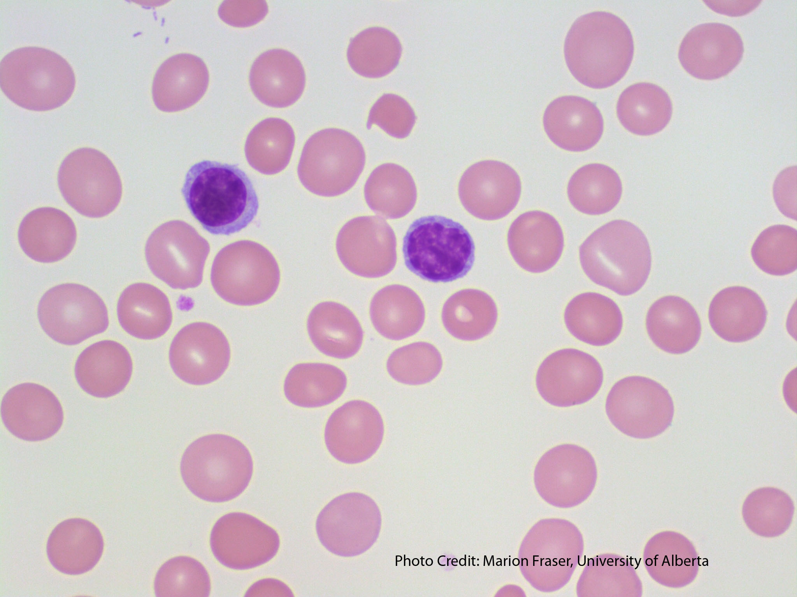
Attention to Anemia
a. Oral or IV Tx for Iron to correct Iron Deficiency
b. Erythropoietin-stimulating agents to address low EPO via injection or IV infusion
Anemia due to CKD
c. Blood transfusions to increase RBC count

Slide 15
New Ideas on Renal Care - KERENDIA
HOW MIGHT THE MANAGEMENT OF ANEMIA DUE TO CK
significantly slowed CKD progression¹
Primary composite endpoint consisted of end-stage kidney disease,* a sustained decline of ≥40% in eGFR from baseline over ≥4 weeks, or renal death.¹
The treatment effect reflected a reduction in a sustained decline in eGFR of ≥40% and progression to kidney failure. There were few renal deaths during the trial.
INDICATION:
KERENDIA is indicated to reduce the risk of sustained eGFR decline, end-stage kidney disease, cardiovascular death, non-fatal myocardial infarction, and hospitalization for heart failure in adult patients with chronic kidney disease (CKD) associated with type 2 diabetes (T2D)
E IMPACTING YOUR PATIENTS AND YOUR PRACTICE?
HOW MIGHT THE MANAGEMENT OF ANEMIA DUE TO CKD BE IMPACTING YOUR PATIENTS AND YOUR PRACTICE?

Slide 16
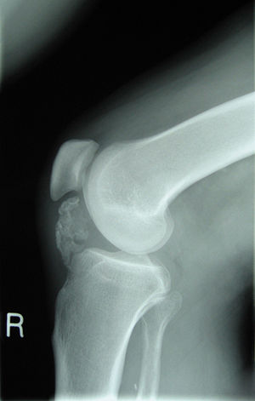
Why Renal Care? ( if not ?)
Daily accumulation of waste products within the body
Unable to remove side reaction of drugs in the body
Electrolyte imbalance leading to dehydration
Imbalance of hormones that regulate BP
Affects Vitamin D production affecting Bone & Neoplasia
Affects the metabolism of RBC
This Photo by Unknown Author is licensed under CC BY-SA

Slide 17
Best Patient Care & Client Communication
Highest quality medicine available to patients & clients
Pain, Discomfort & Suffering ( Veterinary Oath)
Animal Advocacy
ADDS
Client Education on Life Longevity and Preventive Medicine

Slide 18
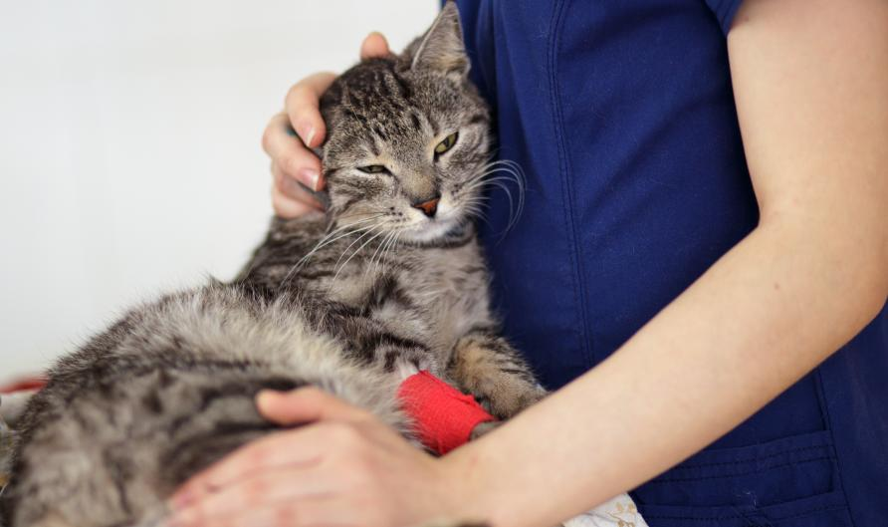
Dont’s & Dos
Random Choice of Food
Snack with high Na +
Random/incidental care
Passive & symptomatic care by clinician
Passive Rx planning
Low but High Quality Prot.
Specially Prepared low Na Snack/Treat
Q 2month medical check & Potential Dialysis if needed
Tele-medicine for Vital Signs
Protocols and Show & Tells
This Photo by Unknown Author is licensed under CC BY-ND

Slide 19
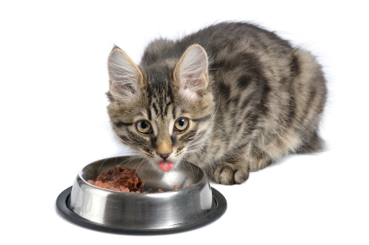
Available Products & Supplements for CKD
AminAvast
Probiotics
Phosphate Binders
Electrolyte
Hb supplement
Urine Acidifier
Low Na, Phosphorus diet
Higher Quality Protein but Low Protein Diet
Corresponding Treats
Plenty of Fresh Water

Slide 20
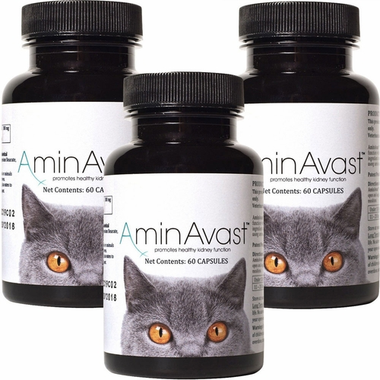
About AminAvast®
AminAvast®
Nutritional Supplement to Help Support Cats’ and Dogs’
Natural Kidney Functions
Used as Tx & Prevention as well as
Maintenence
Maintain the health of aging kidney
Complements a Protein Restricted Diet.
Maintains normal renal health.
Supports normal renal cell structure.
Maintains natural low levels of oxidative stress.
Supports a healthy coat.
Supports overall health and vitality.

Slide 21
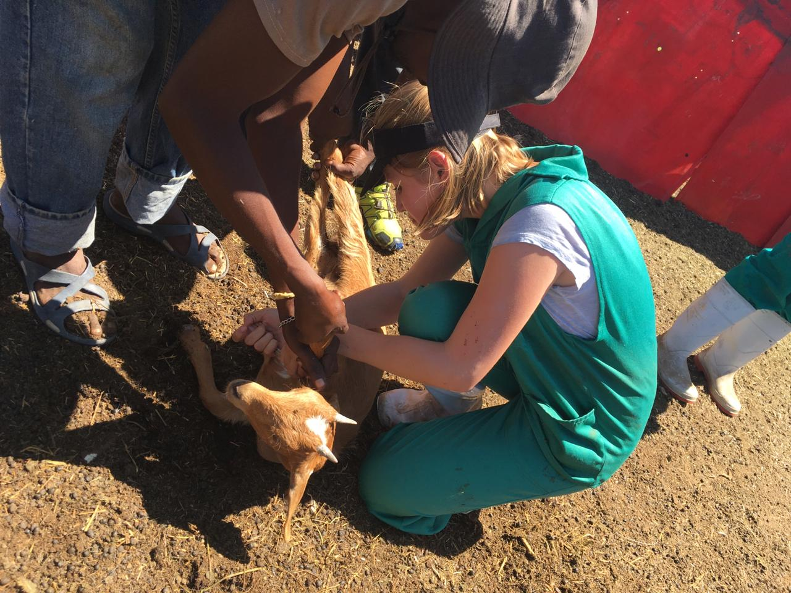
4 Principles of Preventive Medicine
Early Education
Early Dx
Early Tx
Salvaging
This Photo by Unknown Author is licensed under CC BY-SA

Slide 22
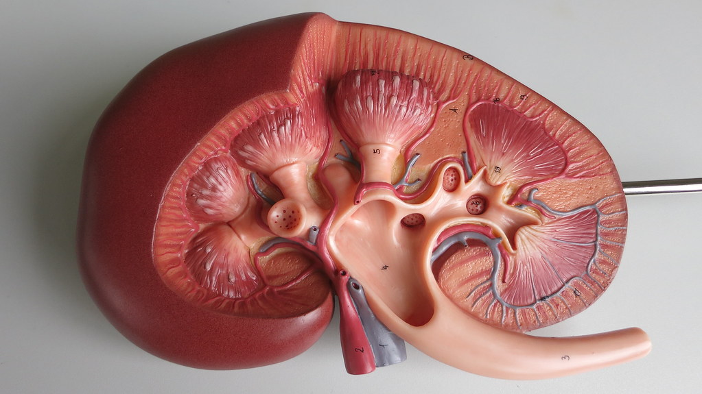
Conclusion
Irreversible nature of Renal Disease
Preventable @ least cost involvement
NMNM for constant monitoring
Consider other critical organs collaborating with Kidney
Crucial Client Education through Show-n-Tell @ early stage intervention for Preventive Medicine
Preventive Use of Rx, Diet supplements

Slide 23
Staff Training Leads to Client Education

Slide 24
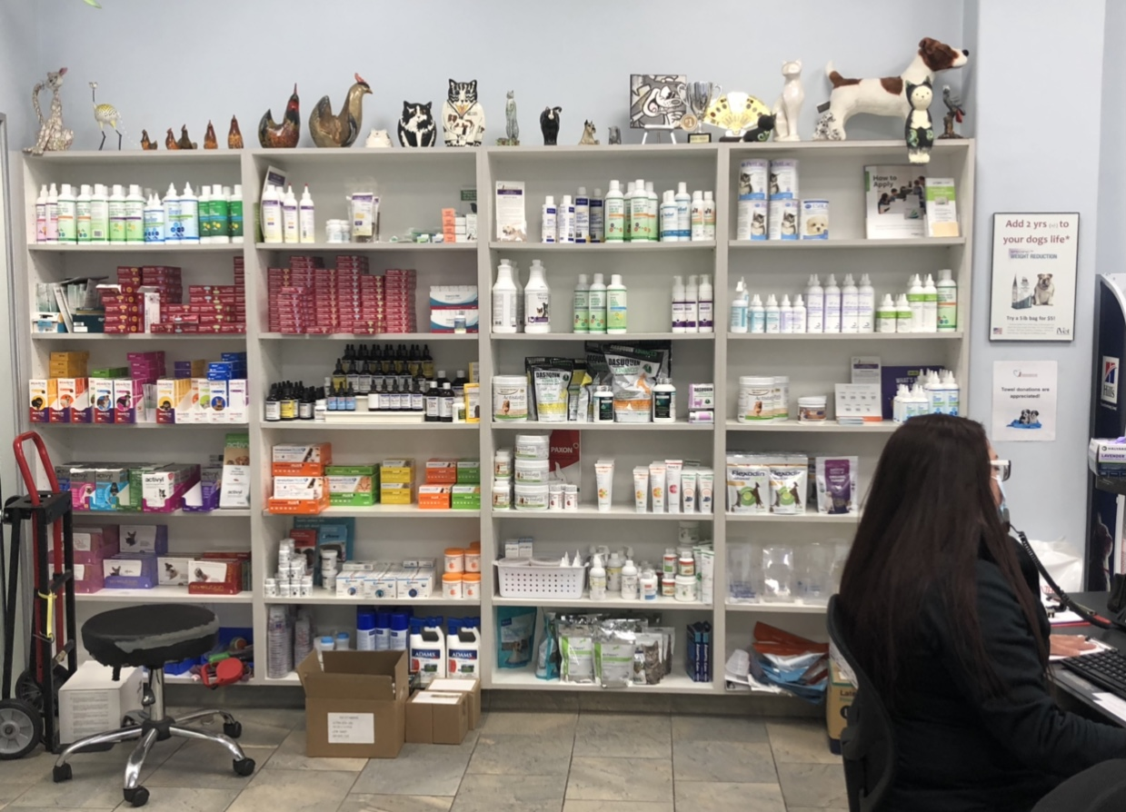

Slide 25
Extensively Used Technology @ Present Moment

Slide 26
Marketing & Sales Don’t Belong to Professionals

Slide 27
Work & Life Balance

Slide 28
Q & A
Appreciation for the Hosting and Sponsorship
Henry K. Yoo, DVM MSc MBA
Infinity Medical Consulting & Co.
Santa Monica, Calif. USA
Executive Consultant & Preventive Medicine Advisor.
henryyoo@gmail.com, 310 990 1384

